Slide 1
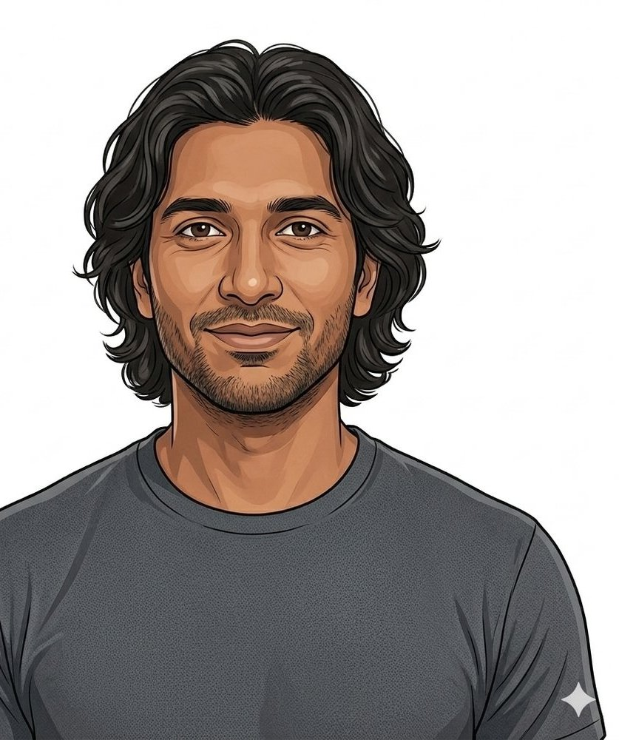
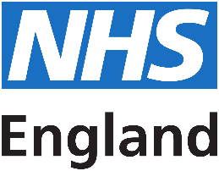
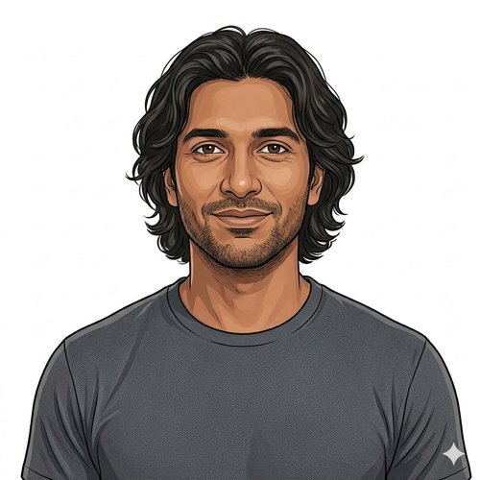
HEARTS AND MINDS · A PATIENT'S STORY THROUGH THE OPERATING MODEL
Abdul.
Hidden risk, found by his app.
Abdul is 38, works full-time, has young kids, and knows heart trouble runs in his family. The NHS App nudges him toward a home test that catches cardiovascular risk markers nobody else was going to find. This is the story of how the cohort gets identified before the symptoms show up.
Abdul
Self-initiated patient · CVKM cohort
Hearts and Minds · Abdul's journey · HomeTest operating model · September 2026
Commercial positions are agreed in principle and remain subject to the live procurement.
Notes:
Abdul's story, told through the operating model. Open on the person, not the pathway.

Slide 2
ABDUL'S JOURNEY AT A GLANCE
The system finds him before the symptoms find him.
1
→
2
→
3
→
4
→
5
Stratification
Identification
Diagnosis
Treatment
Long-term optimisation
the cohort the system cannot see yet
the NHS App finds him
kit out, sample back
the conversation the result triggers
the cycle that fits his life
THE PATIENT NORTH STAR
WHY THIS WORKS FOR HIM
The system finds him before the symptoms find him.
The NHS App is the front door. The kit is the test. The result is in his record.
Abdul does not feel ill. He has never been to the GP about his heart. The cohort he belongs to, middle-aged men with family-history risk, is exactly the cohort the in-clinic system finds last. The home pathway finds him first.
No clinic visit to book. No phlebotomist to find a slot with. No half-day off work. The kit arrives. He takes the sample. The result lands in the system he already uses for everything else.
Abdul
Self-initiated patient · CVKM cohort
Hearts and Minds · Abdul's journey · HomeTest operating model · September 2026
Commercial positions are agreed in principle and remain subject to the live procurement.
2

Slide 3

ABDUL'S JOURNEY · STAGE 1 OF 5
01
Stratification
the cohort the system cannot see yet
Abdul is 38, married, two young kids. Sat all day, knows his diet isn't great. Heart problems run in the family. His single patient record holds his age, BMI, smoking history, family history of heart disease and diabetes. AI-assisted risk stratification reads all of it and flags him as high risk for CVKM. The information has been there all along; this is the first time something reads it.
“I am 38, I work full-time, my wife works full-time, we have two young kids. My dad had his first MI at 51. The system had all of this in my record already. It just needed something to read it and tell me.” Abdul
WHAT THE MODEL IS DOING UNDERNEATH
THE OLD WAY
AI-assisted CVKM risk stratification reads structured and unstructured data on Abdul's single patient record: age, BMI, smoking history, family history of heart disease and diabetes. He is flagged as high cardiovascular risk and added to a contact list. The mechanic that finds him is automated, dynamic and continuous.
Wait until presentation: a chest pain, a stroke, an A&E visit. The single patient record already had every prompt the system needed. Nothing read it. The first contact was the event the system was supposed to prevent.
WHO ABDUL'S CARE TEAM SEES Sarah's commissioner cohort analysis. Population health analysts. Public-health team identifying the at-risk cohort.
Hearts and Minds · Abdul's journey · HomeTest operating model · September 2026
Commercial positions are agreed in principle and remain subject to the live procurement.
3
Notes:
Stage 1: Stratification. AI-assisted CVKM risk stratification reads structured and unstructured data on Abdul's single patient record: age, BMI, smoking history, family history of heart disease and diabetes. He is flagged as high cardiovascular risk and added to a contact list. The mechanic that finds him is automated, dynamic and continuous.

Slide 4
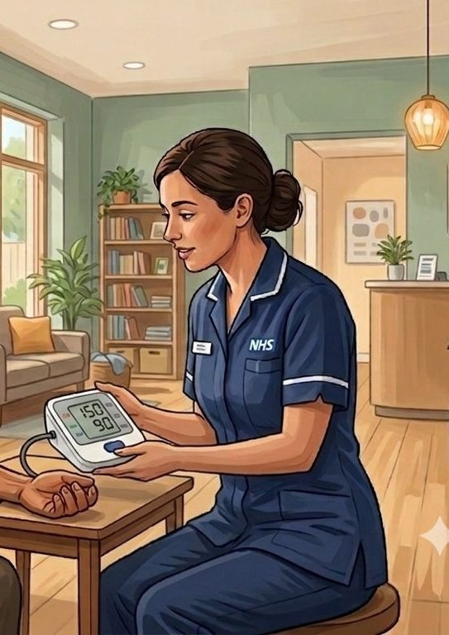
ABDUL'S JOURNEY · STAGE 2 OF 5
02
Identification
the NHS App finds him
Abdul opens the NHS App that morning to look at a prescription. The new Blood Pressure tool uses his phone camera; the reading is 150 over 90. The app recommends a CVKM Check Up. He shares his smartwatch data, which shows low activity and trending-high BP, then books in. The app tells him the BP reading needs re-testing with a medically validated cuff before anything clinical lands.
“I checked my BP using the camera on my phone because heart problems run in the family. It read 150 over 90. The app told me to book a CVKM Check Up. I did not have to chase anything.” Abdul
WHAT THE MODEL IS DOING UNDERNEATH
THE OLD WAY
NHS App BP camera tool reads against medical-grade thresholds; result triggers the CVKM Check Up pathway as a digital service inside the App. Smartwatch biosensor data flows in. The app states the camera reading needs medically validated re-test before clinical action: the digital reading is a prompt, not a diagnosis.
A campaign letter or a generic health prompt that broadcasts at everyone and reaches the engaged. Abdul, in work, no symptoms, would not have engaged.
WHO ABDUL'S CARE TEAM SEES Priya on the platform side, owning App surfacing. Cohorting-as-a-service. UKHSA data overlay.
Hearts and Minds · Abdul's journey · HomeTest operating model · September 2026
Commercial positions are agreed in principle and remain subject to the live procurement.
4
Notes:
Stage 2: Identification. NHS App BP camera tool reads against medical-grade thresholds; result triggers the CVKM Check Up pathway as a digital service inside the App. Smartwatch biosensor data flows in. The app states the camera reading needs medically validated re-test before clinical action: the digital reading is a prompt, not a diagnosis.

Slide 5
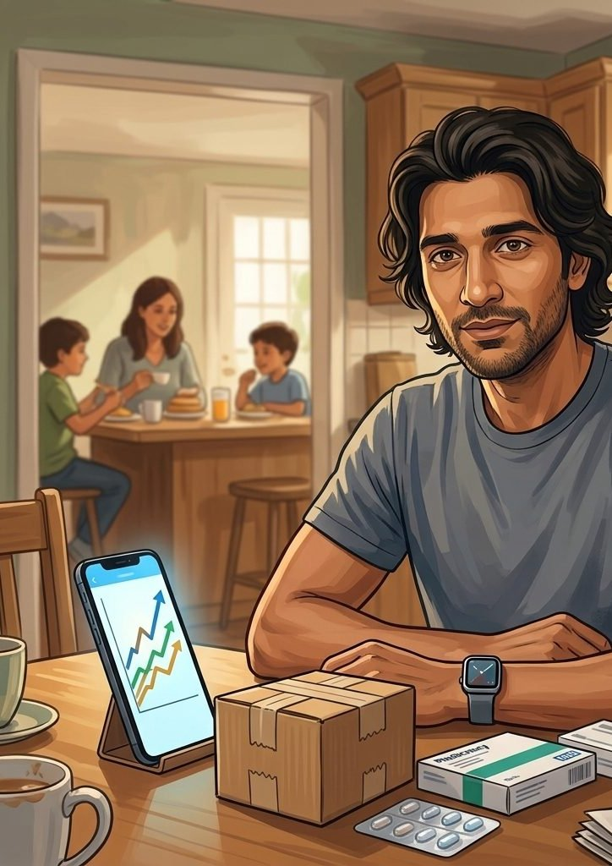
ABDUL'S JOURNEY · STAGE 3 OF 5
03
Diagnosis
kit out, sample back
At his Neighbourhood Health Centre the nurse validates his BP with a medical cuff and runs an Atrial Fibrillation check. Abdul dislikes needles, so the nurse shows him a new arm-stick blood self-sample device. She lends him a 24-hour Ambulatory BP smart ring to wear home. Two days later the ring confirms Stage 1 Hypertension and the blood results come back: high cholesterol and pre-diabetes. The home pathway proved the same diagnosis the old clinic pathway would have, on his time.
“The ring on my finger told me I had Stage 1 Hypertension before any clinician did. The blood result came two days later. It was the same diagnosis I would have got at the clinic. It just happened around me.” Abdul
WHAT THE MODEL IS DOING UNDERNEATH
THE OLD WAY
A medically validated BP cuff and an AF check at the centre. A 24-hour Ambulatory BP smart ring for the diagnostic confirmation. An MHRA-regulated home blood self-sample kit, processed by a UKAS-accredited lab, surfaces high cholesterol and pre-diabetes. Results write back to Abdul's NHS record. High cholesterol and pre-diabetes get found together, not on three separate visits.
A GP appointment for the BP. A second to take blood. A third to discuss results. Three clinic slots, three half-days off. Same diagnosis at the end.
WHO ABDUL'S CARE TEAM SEES The framework supplier shipping the kit. The lab. The platform writing the result back. Abdul.
Hearts and Minds · Abdul's journey · HomeTest operating model · September 2026
Commercial positions are agreed in principle and remain subject to the live procurement.
5
Notes:
Stage 3: Diagnosis. A medically validated BP cuff and an AF check at the centre. A 24-hour Ambulatory BP smart ring for the diagnostic confirmation. An MHRA-regulated home blood self-sample kit, processed by a UKAS-accredited lab, surfaces high cholesterol and pre-diabetes. Results write back to Abdul's NHS record. High cholesterol and pre-diabetes get found together, not on three separate visits.

Slide 6
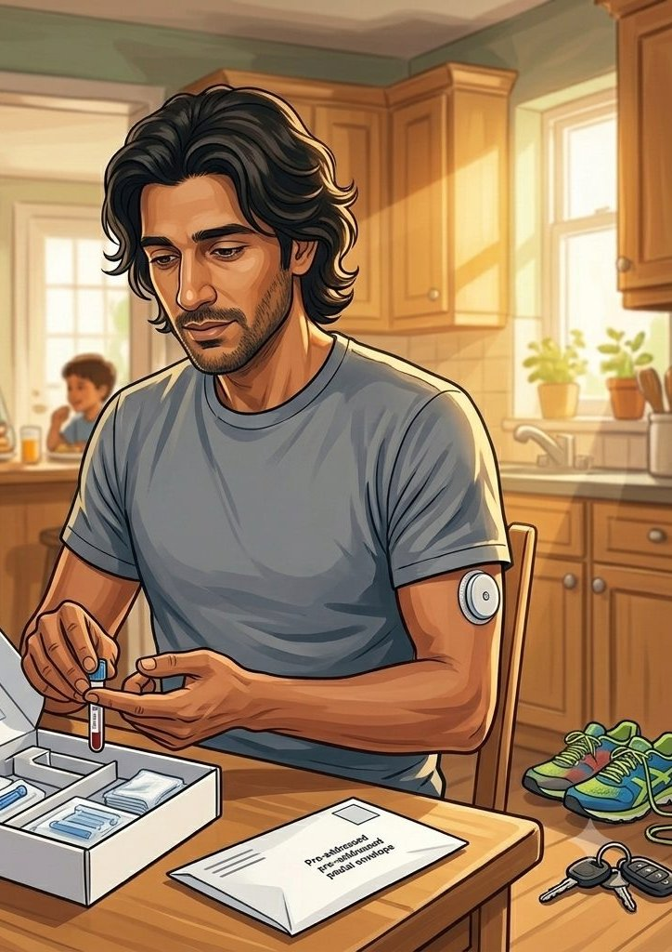
ABDUL'S JOURNEY · STAGE 4 OF 5
04
Treatment
the conversation the result triggers
A clinician messages Abdul via the NHS App and asks him to book. She prescribes a CVKM long-term condition management app, plus a GLP-1, statins and an ACE inhibitor. She refers him to the pre-diabetes prevention programme and checks that his smartwatch is accurate enough to monitor his BP. Eight weeks later the diabetes team messages and asks him to take a self-sample HbA1c test at home; he posts it back. The HbA1c has already dropped. They send him a CGM device.
“She prescribed me the heart and circulation app, the statins, the GLP-1 and an ACE inhibitor. She put me on the pre-diabetes programme. Eight weeks later I took a HbA1c blood test at the kitchen table and posted it. The HbA1c had dropped. The CGM came through the post.” Abdul
WHAT THE MODEL IS DOING UNDERNEATH
THE OLD WAY
NICE-guideline-aligned prescription cocktail through the NHS App. A long-term CVKM management app delivered through HealthStore. A pre-diabetes prevention programme runs alongside. The 8-week HbA1c retest is the HomeTest moment inside a longer DTx-led pathway; the CGM follows because the HbA1c moved. None of this needs Abdul to take time off work.
A GP appointment for the result conversation. A second for the HbA1c retest. A third for the CGM. The clinical decisions were always the same; the venues were the friction.
WHO ABDUL'S CARE TEAM SEES Abdul's GP. Practice pharmacist if a statin is prescribed. NICE guidelines.
Hearts and Minds · Abdul's journey · HomeTest operating model · September 2026
Commercial positions are agreed in principle and remain subject to the live procurement.
6
Notes:
Stage 4: Treatment. NICE-guideline-aligned prescription cocktail through the NHS App. A long-term CVKM management app delivered through HealthStore. A pre-diabetes prevention programme runs alongside. The 8-week HbA1c retest is the HomeTest moment inside a longer DTx-led pathway; the CGM follows because the HbA1c moved. None of this needs Abdul to take time off work.

Slide 7
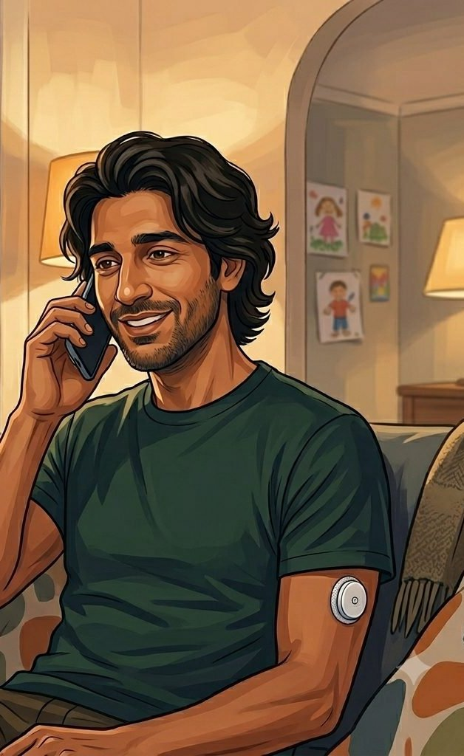
ABDUL'S JOURNEY · STAGE 5 OF 5
05
Long-term optimisation
the cycle that fits his life
Abdul uses the CVKM long-term condition management app to track his weight, diet and activity. He earns rewards and stays engaged. Community nurses receive alerts when his readings step outside his individual range and contact him by video call to review. The pharmacist at his health centre reviews his BP readings and remotely adjusts his medication until his BP reaches control; the updated prescription comes through the post. Later, he calls his mum Liz (64) and walks her through the whole thing.
“The system has me on its list. The community nurse rings on video if my BP shifts. My pharmacist titrates my dose without me having to be there. The HomeTest kit comes through the post when I am due. Mum was worried it sounded complicated; I told her she could still do all of it with her own GP if she preferred.” Abdul
WHAT THE MODEL IS DOING UNDERNEATH
THE OLD WAY
Continuous self-monitoring via the CVKM app and biosensor data. Video-call reviews replace periodic in-person ones. Pharmacist-led remote medication titration replaces clinic appointments for dose changes. Periodic HomeTest retests on calendar reminder via post. Liz, his 64-year-old mother, is the cast around him: the same pathway has to work for her too.
A five-yearly NHS Health Check in clinic. A periodic dose-review appointment. A separate one for the CGM check. Most of the cohort missing most of the cycle, and the cardiovascular events arriving regardless.
WHO ABDUL'S CARE TEAM SEES Abdul. His GP holding the longitudinal record. The NHS App. Aisha's clinical safety review of the cohort-level pattern.
Hearts and Minds · Abdul's journey · HomeTest operating model · September 2026
Commercial positions are agreed in principle and remain subject to the live procurement.
7
Notes:
Stage 5: Long-term optimisation. Continuous self-monitoring via the CVKM app and biosensor data. Video-call reviews replace periodic in-person ones. Pharmacist-led remote medication titration replaces clinic appointments for dose changes. Periodic HomeTest retests on calendar reminder via post. Liz, his 64-year-old mother, is the cast around him: the same pathway has to work for her too.

Slide 8
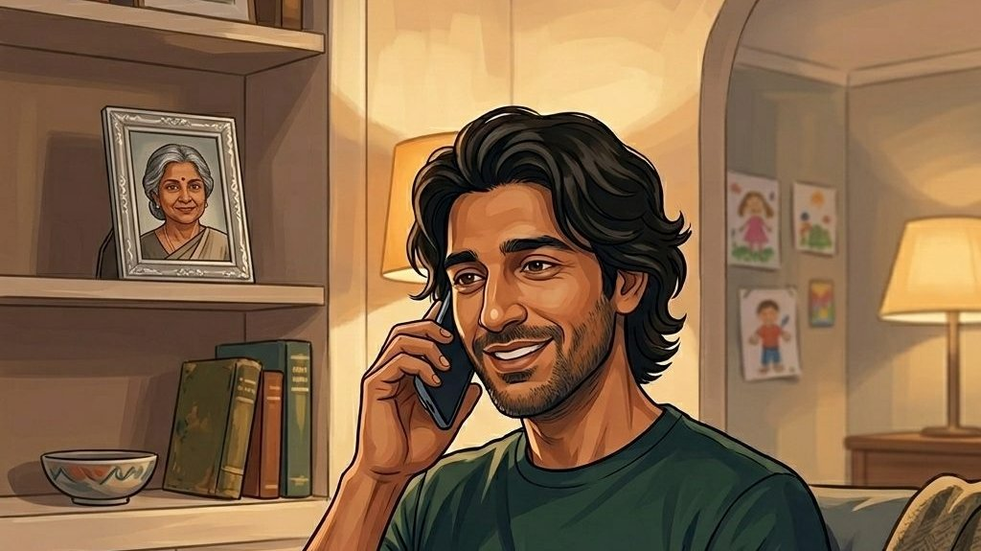
ABDUL'S WIN
A cohort identified before the symptoms. A diagnosis made around his life, not against it. A treatment cycle that runs through messages, the post and his phone, with the clinical conversations happening exactly where they need to.
THE MONEY IN THIS STORY
Abdul never sees a bill. His check is commissioned for him, free at the point of use through the NHS App. Behind it, the commissioner pays the supplier a cost per activity for each completed test, against a national ceiling that local volume pushes down. The clinic appointment he did not need stays available for someone who does, and that is where the saving lands: the kit costs pounds, the staffed slot it replaces costs far more.
Abdul does not see infrastructure. He sees an app he already uses, a kit through the door, and a GP conversation that finally has the data it needed. The cardiovascular event that did not happen is the event that did not get measured because Abdul was found in time.
The system finds him before the symptoms find him.
Abdul
Self-initiated patient · CVKM cohort
Hearts and Minds · Abdul's journey · HomeTest operating model · September 2026
Commercial positions are agreed in principle and remain subject to the live procurement.
8

Slide 9
Abdul
Self-initiated patient · CVKM cohort
The system finds him before the symptoms find him.
Hearts and Minds · Abdul's journey · HomeTest operating model · September 2026
Commercial positions are agreed in principle and remain subject to the live procurement.
9

